Slide 1
Artificial Intelligence
Notes:
OWEN: Insert chapter number

Slide 2
DEFINITION
AI – the branch of computer science that is concerned with the automation of intelligent behavior
  Sound theoretical and applied principles
  Data structures for knowledge representation
  Algorithms of applying knowledge
  Languages for algorithm implementation
Problem
  What is Intelligence?

Slide 3
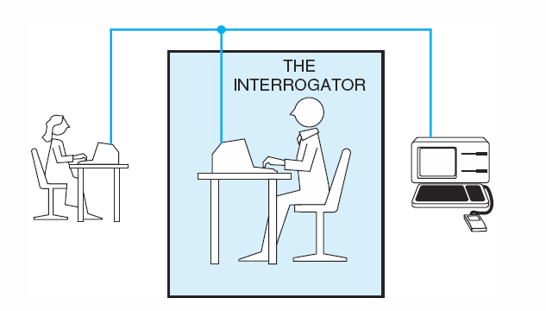
THE TURING TEST
The interrogator
cannot see and speak to either
does not know which is actually machine
May communicate with them solely by textual device
If the interrogator cannot distinguish the machine from the human, then the machine may be assumed to be intelligent.

Slide 4
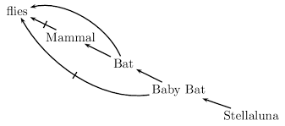
MODELS OF INTELLIGENCE
Logic Models
  Formal logic Truth table
  Probability logic - Bayesian
  Fuzzy logic – Multiple true conditions
  Non-monotonic logic -
Biological Models
  Connectionist model
  Genetic algorithms
  Evolution
Social Models
  Network models
  Behaviors
Agents -- Combination

Slide 5
AGENTS THEORIES
Intelligence is reflected by a collective behaviors of large numbers of very simple interacting, semi -autonomous individuals – agents
Various agents
  Rote agents
  Coordination agents
  Search agents
  Learning agents
  Decision agents
Agents design
  Structure for information representation
  Search strategies
  Architecture for supporting the interaction of agents

Slide 6
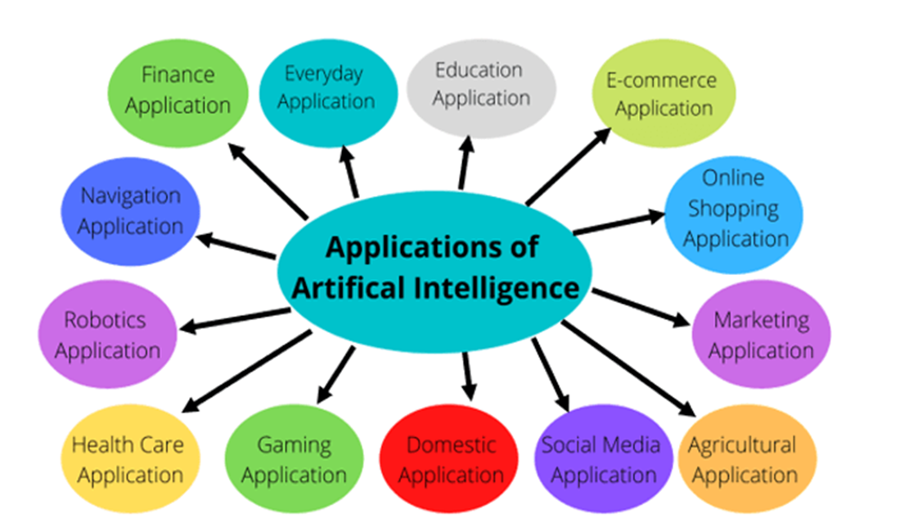
AI RESEARCH AND APPLICATION AREAS

Slide 7
Important Features of Artificial Intelligence
Reasoning, pattern recognition, learning - Inference.
Heuristic search for non-algorithmic solutions.
Problem-solving using inexact, missing, or poorly defined information using representational formalisms
Reasoning - Qualitative features of a situation.

Slide 8
Important Features of Artificial Intelligence
Deals with semantic meaning as well as syntactic form.
Obtaining answers that are neither exact nor optimal, but sufficient
Expert systems - Solving problems using large amounts of domain-specific knowledge
Problem-solving with meta-level knowledge to control strategies

Slide 9
Artificial Intelligence as Representation and Search

Slide 10
REPRESENTATION SYSTEMS
What is it?
  Capture the essential features of a problem domain and make that information accessible to a problem-solving procedure
Measures to evaluate
  Abstraction – how to manage complexity
  Expressiveness – what can be represented
  Efficiency – how is it used to solve problems
Trade-off between efficiency and expressiveness

Slide 11
Features of AI Representation Language:
Handle qualitative Knowledge
Allow new knowledge to be inferred from a set of facts and rules
Allow representation of general principles as well as specific situations
Capture complex semantic meaning
Allow meta-level reasoning

Slide 12
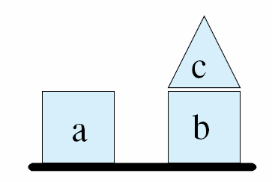
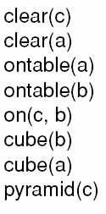

Block World Representation
A blocks world
Logical Clauses describing some important properties and relationships
General rule

Slide 13
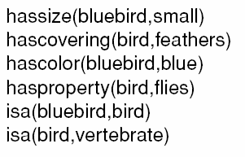
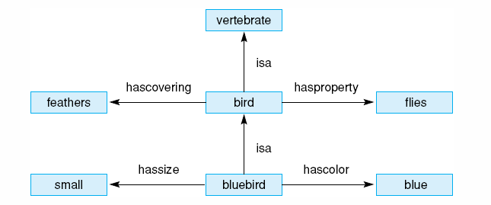
Bluebird Representations
A bluebird is a small blue-colored bird and a bird is a feathered flying vertebrate.
Logical predicates representing a simple description of a bluebird.
Semantic network description of a bluebird.

Slide 14
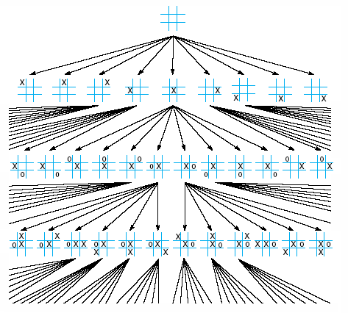
Tic-tac-toe State Space
Portion of the state space for tic-tac-toe.

Slide 15
STATE SPACE SEARCH- PROBLEM SOLVING
State space
  State – any current representation of a problem
  State space
    All possible state of the problem
    Start states – the initial state of the problem
    Target states – the final states of the problem that has been solved
  State space graph
    Nodes – possible states
    Links – actions that change the problem from one state to another
State space search
  Find a path from an initial state to a target state in the state space
  Various search strategies
    Exhaustive search – guarantee that the path will be found if it exists
      Depth-first
      Breath-first
    Best-first search
      heuristics

Slide 16
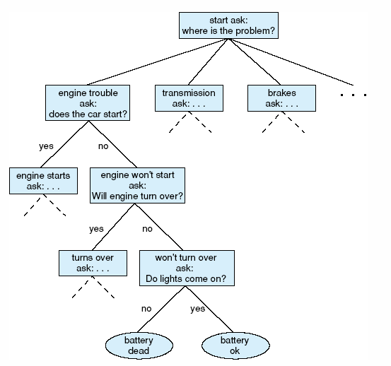
Auto Diagnosis State Space
State space description of the automotive diagnosis problem.

Slide 17

The Predicate Calculus
2.0 Introduction
2.1 The Propositional Calculus
2.2 The Predicate Calculus
2.3 Using Inference Rules to Produce Predicate Calculus Expressions
2.4 Application: A Logic-Based Financial Advisor
Notes:
OWEN: Insert chapter number

Slide 18
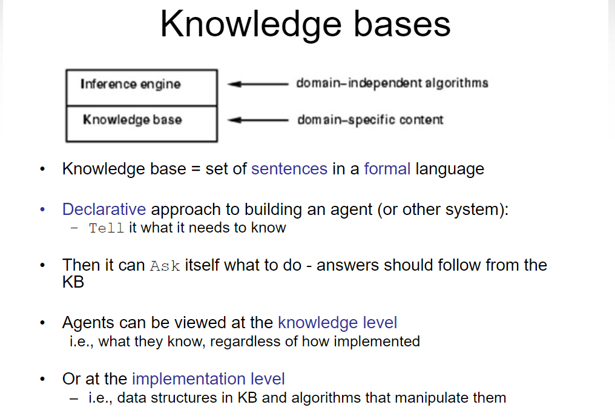
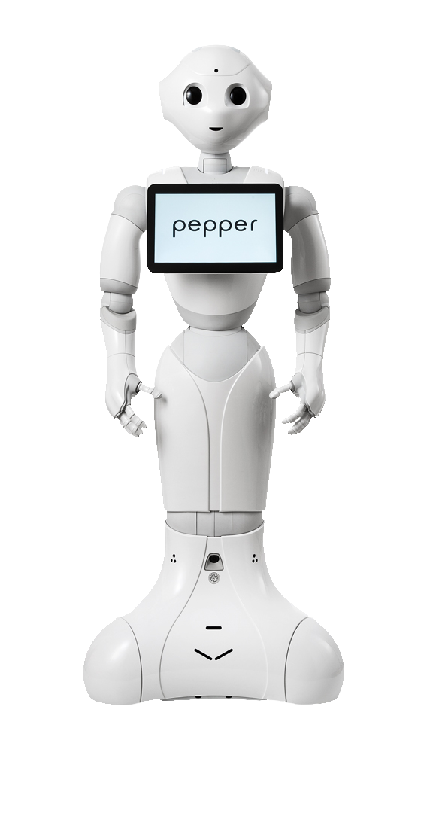

Slide 19
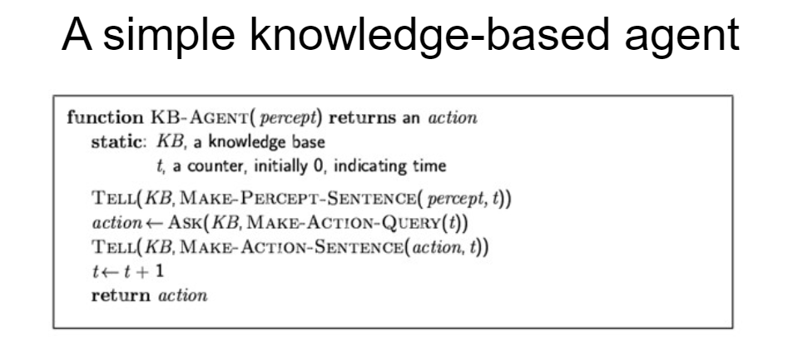
The agent must be able to:
  –Represent states, actions, etc.
  –Incorporate new percepts
  –Update internal representations of the world
  –Deduce hidden properties of the world
  –Deduce appropriate actions

Slide 20
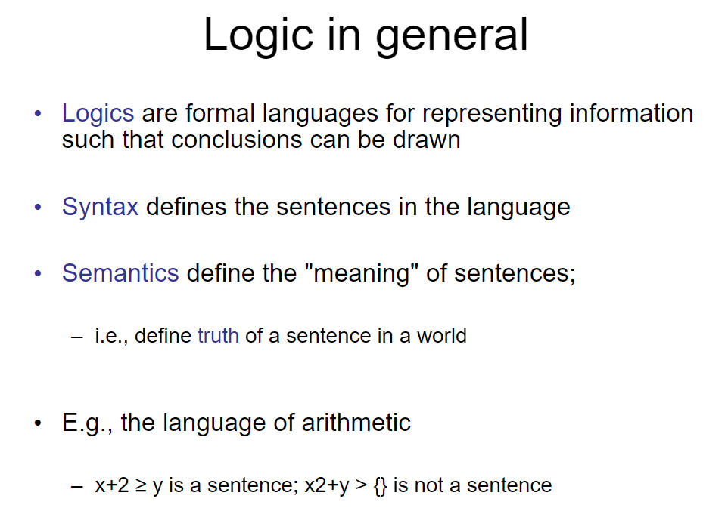

Slide 21
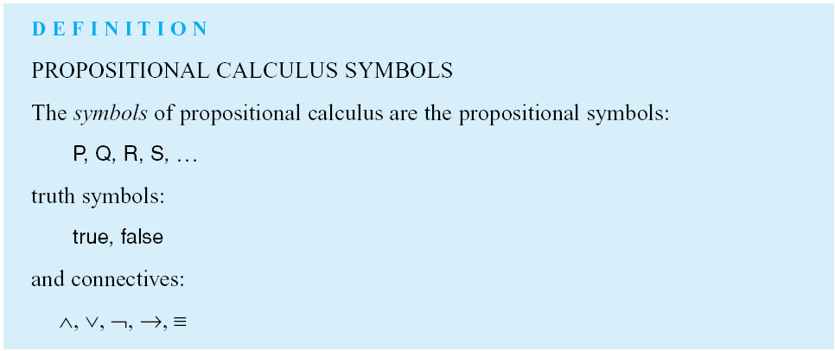
Luger: Artificial Intelligence, 6th edition. © Pearson Education Limited, 2009

Slide 22
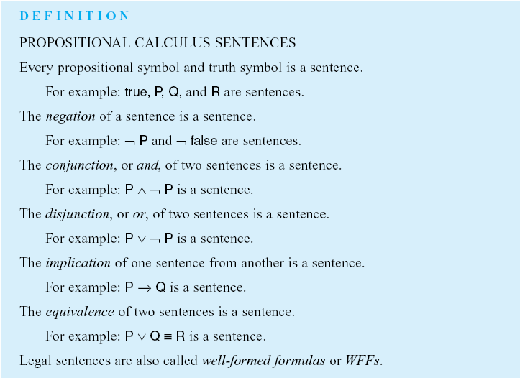
Luger: Artificial Intelligence, 6th edition. © Pearson Education Limited, 2009

Slide 23
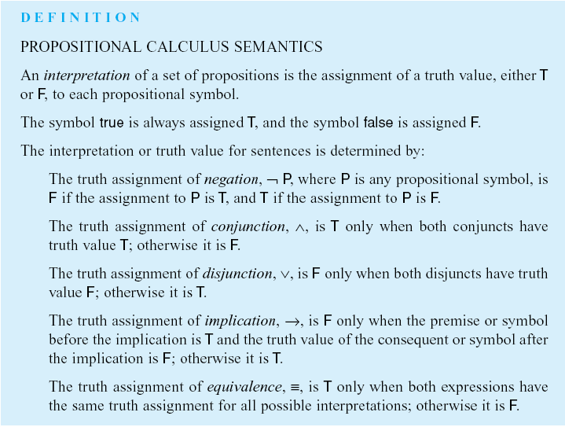
Luger: Artificial Intelligence, 6th edition. © Pearson Education Limited, 2009

Slide 24
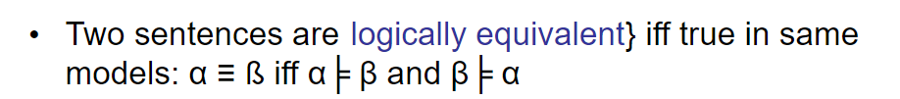
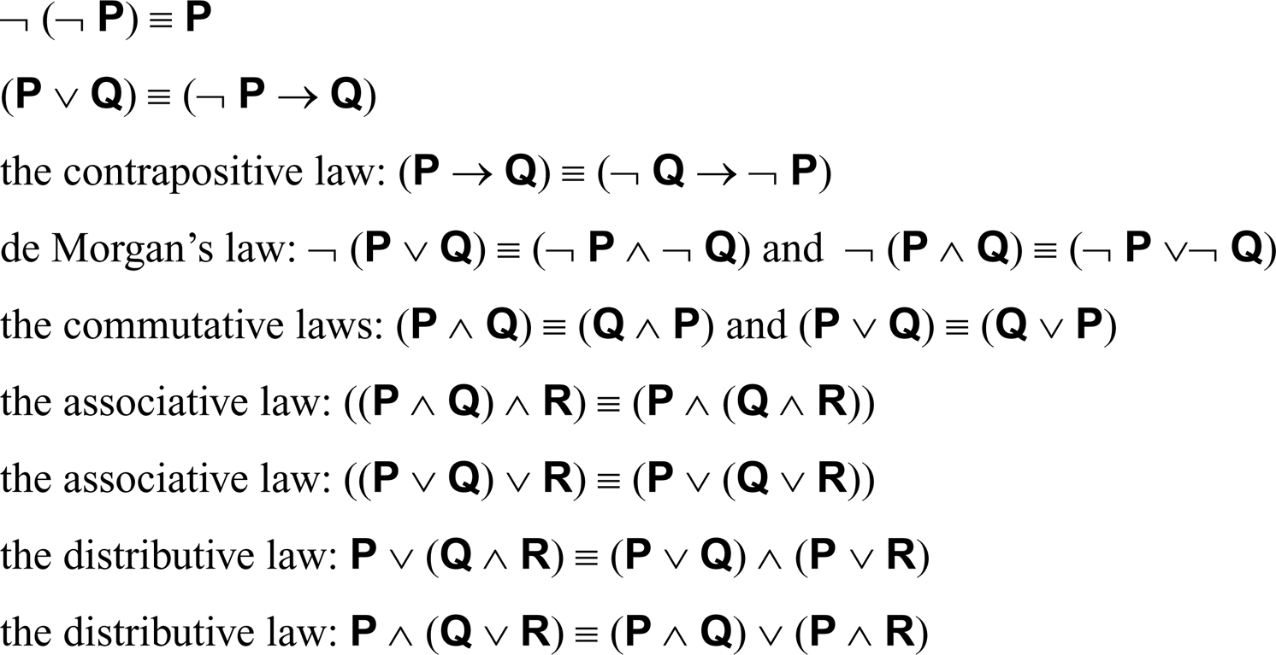
For propositional expressions P, Q and R:
Luger: Artificial Intelligence, 6th edition. © Pearson Education Limited, 2009

Slide 25
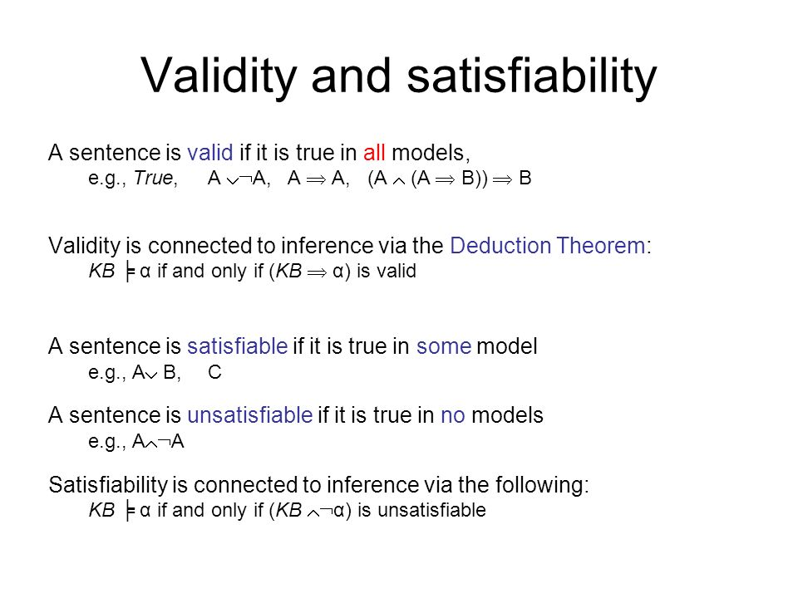
Scheduling people to work in shifts at a hospital
– Some people don’t work at night
– No one can work more than x hours a week
– Some pairs of people can’t be on the same shift
Is there assignment of people to shifts that satisfy all constraints?

Slide 26
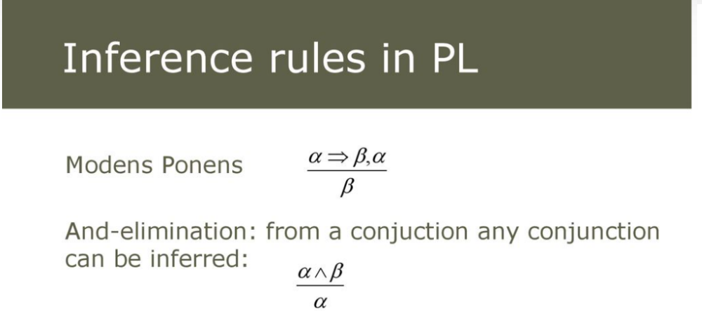
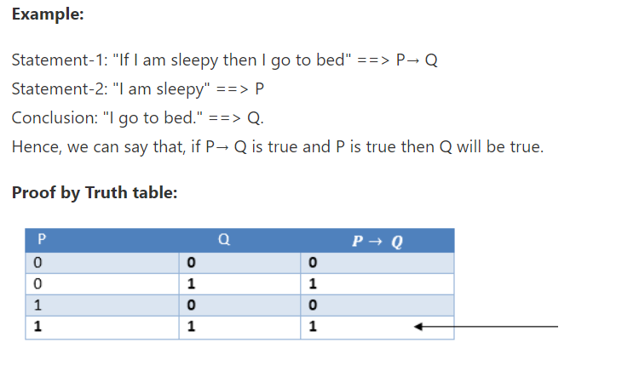

Slide 27
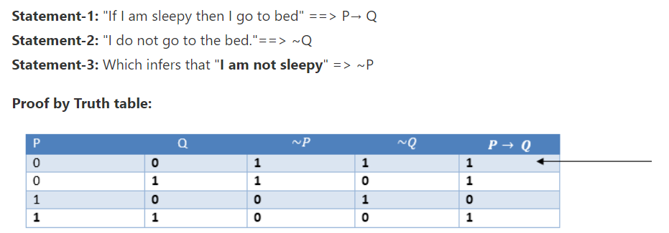
Modus Tollens:
The Modus Tollens rule state that if P→ Q is true and ¬ Q is true, then ¬ P will also true.

Slide 28
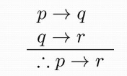
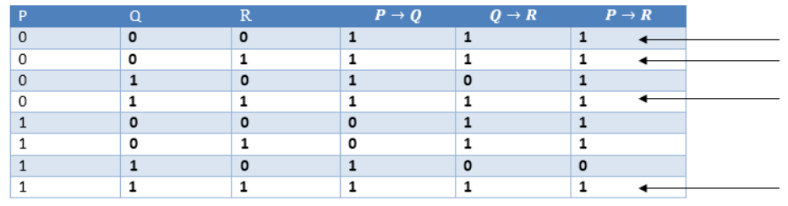
Hypothetical Syllogism:
The Hypothetical Syllogism rule state that if P→R is true whenever P→Q is true, and Q→R is true.
Example:
Statement-1: If you have my home key then you can unlock my home.
P→Q
Statement-2: If you can unlock my home then you can take my money.
Q→R
Conclusion: If you have my home key then you can take my money.
P→R

Slide 29
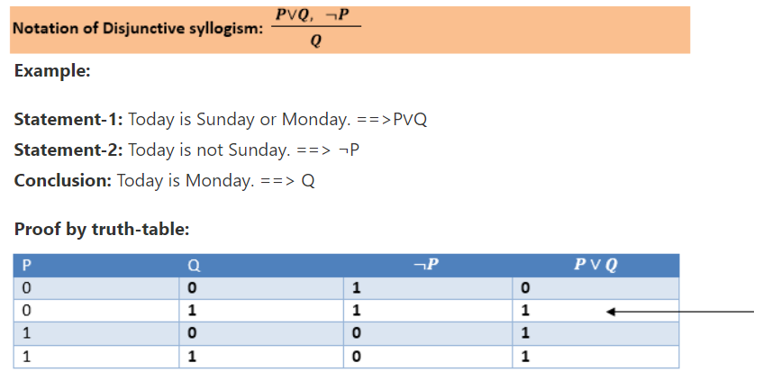
Disjunctive Syllogism:
The Disjunctive syllogism rule state that if P∨Q is true, and ¬P is true, then Q will be true.

Slide 30
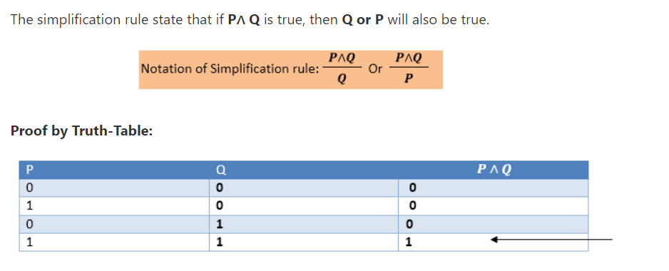
Simplification:

Slide 31
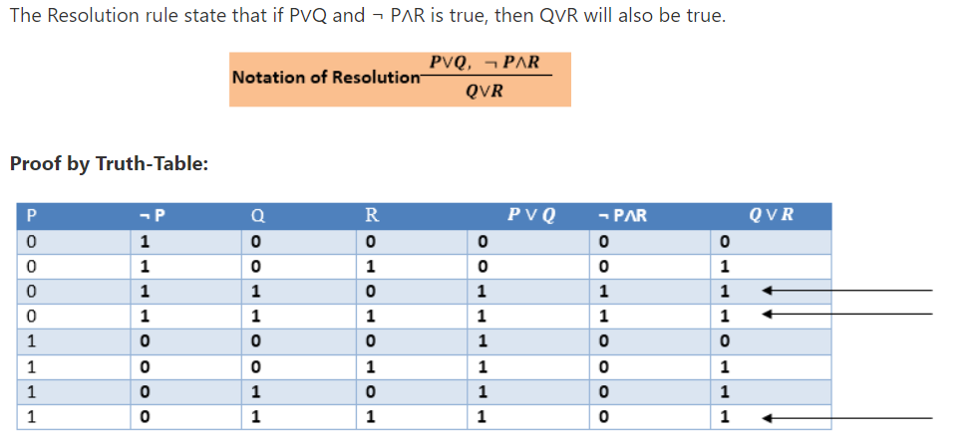
Resolution:

Slide 32
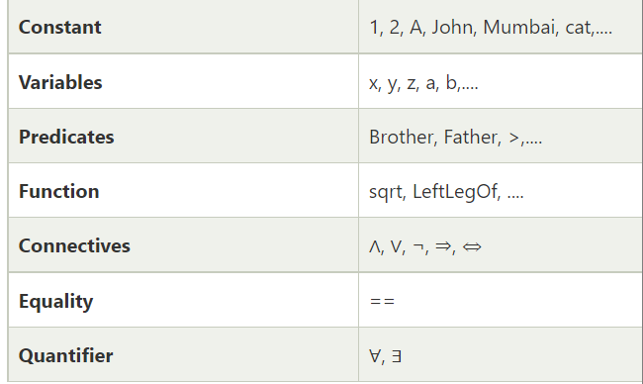
Predicate logic or First-order predicate logic.
Objects: A, B, people, numbers, colors, wars, theories,
Relations: It can be unary relation such as: red, round, is adjacent, or n-any relation such as: the sister of, brother of, has color, comes between
Function: Father of, best friend, third inning of, end of, ......
Basic Elements of First-order logic:

Slide 33
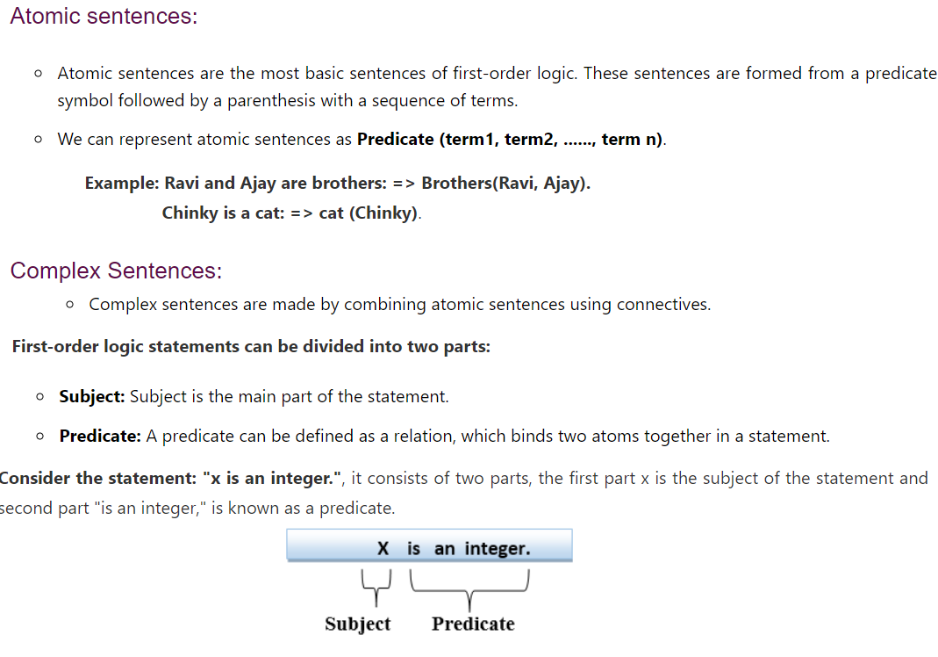

Slide 34
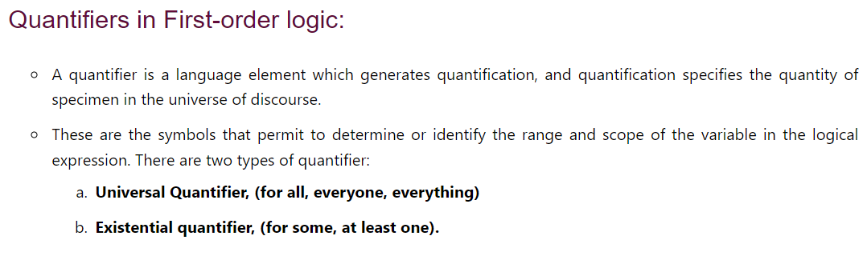

Slide 35
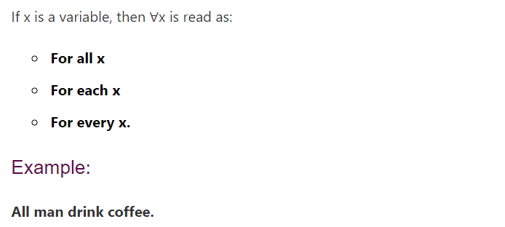

Universal Quantifier:
In universal quantifier, ∀x∀y is similar to ∀y∀x.

Slide 36

Existential Quantifier:
Existential quantifiers are the type of quantifiers, which express that the statement within its scope is true for at least one instance of something.
If x is a variable, then existential quantifier will be ∃x or ∃(x).
In Existential quantifier we always use AND or Conjunction symbol (∧).
Example:
Some boys are intelligent.
∃x: boy(x) ∧ intelligent(x)

Slide 37
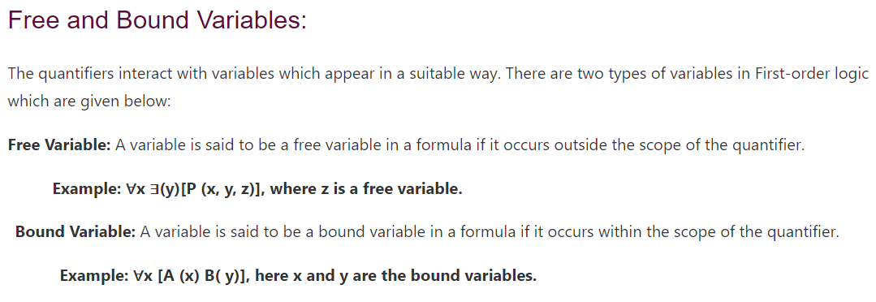

Slide 38
Everyone likes some kind of food
There is a kind of food that everyone likes
Someone likes all kinds of food
Every food has someone who likes it

Slide 39
Everyone likes some kind of food
  ∀P ∃F likes(P,F)
There is a kind of food that everyone likes
  ∃F ∀P likes(P,F)
Someone likes all kinds of food
  ∃P ∀F likes(P,F)
Every food has someone who likes it
  ∀F ∃P likes(P,F)

Slide 40
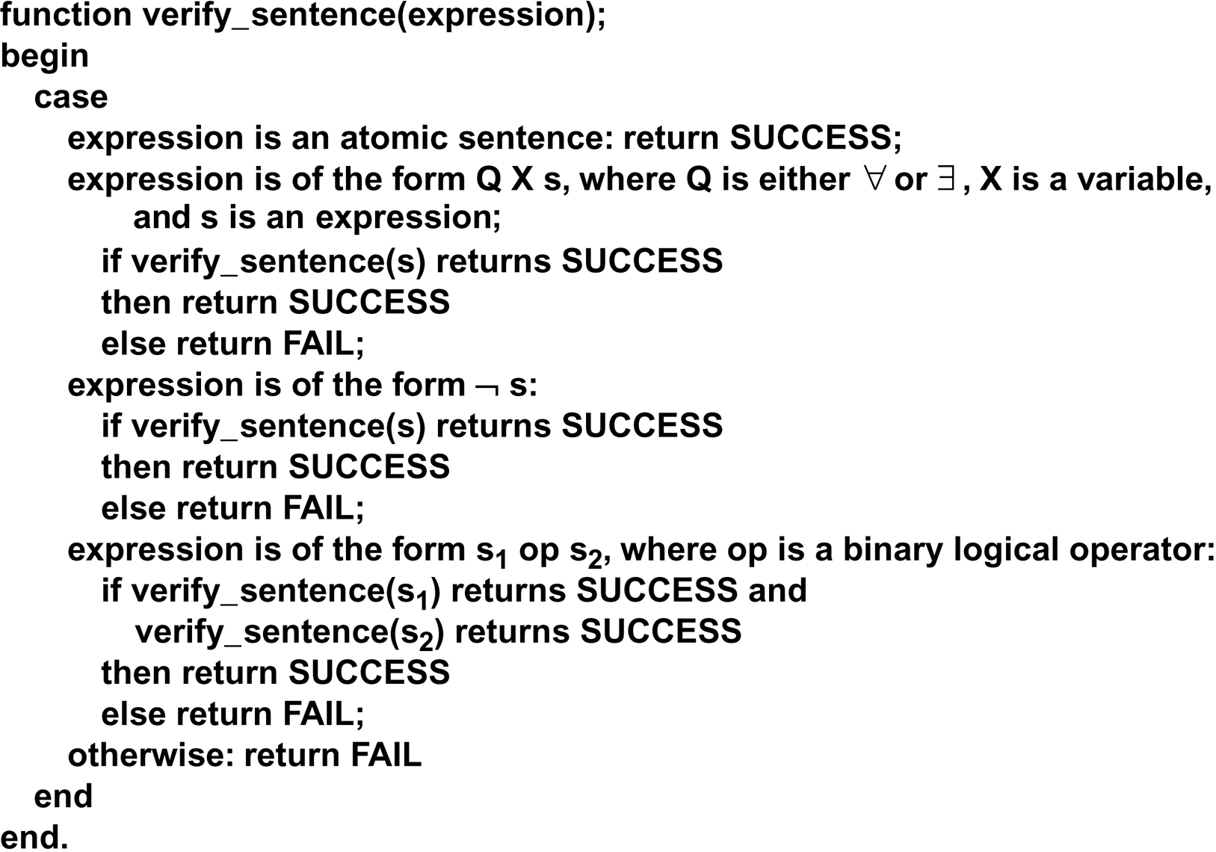
verify_sentence algorithm

Slide 41
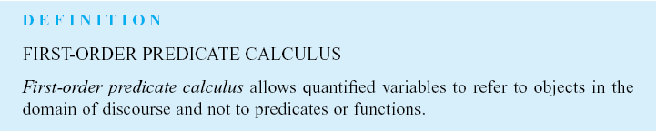

Slide 42
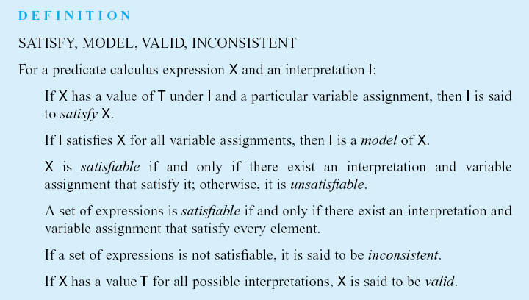
Example:
∃x p(x) ∧ ~p(x) is inconsistent
∀x p(x) V ~p(x) is valid

Slide 43
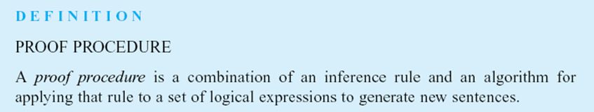

Slide 44
FC: EXAMPLE KNOWLEDGE BASE
The law says that it is a crime for an American to sell weapons to hostile nations. The country Nono, an enemy of America, has some missiles, and all of its missiles were sold to it by Col. West, who is an American.
Prove that Col. West is a criminal.

Slide 45
FC: EXAMPLE KNOWLEDGE BASE
…it is a crime for an American to sell weapons to hostile nations
  American(x) ∧Weapon(y) ∧Sells(x,y,z) ∧Hostile(z) ⇒ Criminal(x)
Nono…has some missiles
  ∃x Owns(Nono, x) ∧ Missiles(x)
  Owns(Nono, M₁) and Missle(M₁)
…all of its missiles were sold to it by Col. West
  ∀x Missle(x) ∧ Owns(Nono, x) ⇒ Sells( West, x, Nono)
Missiles are weapons
  Missle(x) ⇒ Weapon(x)

Slide 46
FC: EXAMPLE KNOWLEDGE BASE
An enemy of America counts as “hostile”
  Enemy( x, America ) ⇒ Hostile(x)
Col. West who is an American
  American( Col. West )
The country Nono, an enemy of America
  Enemy(Nono, America)

Slide 47
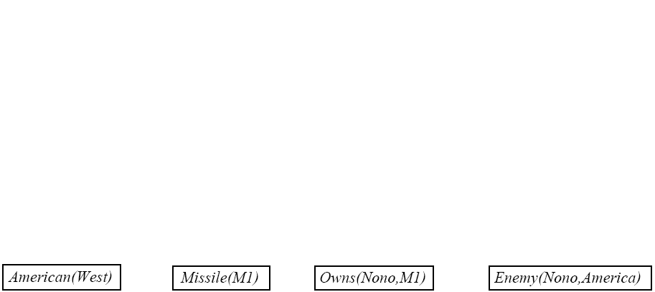
FC: EXAMPLE KNOWLEDGE BASE

Slide 48
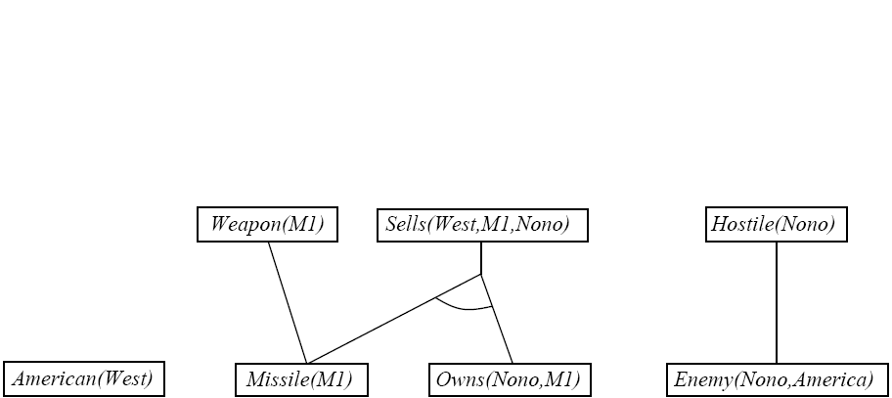
FC: EXAMPLE KNOWLEDGE BASE

Slide 49
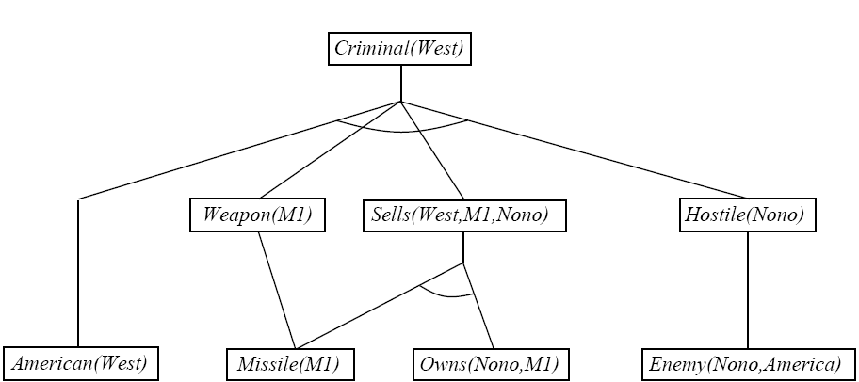
FC: EXAMPLE KNOWLEDGE BASE

Slide 50
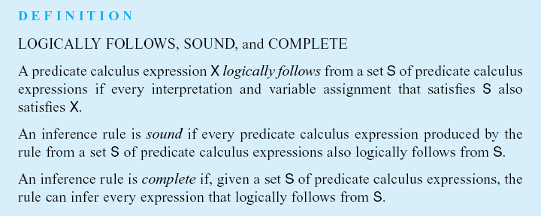

Slide 51
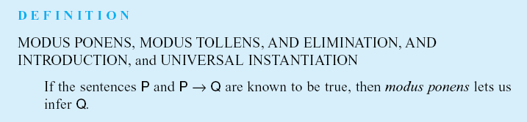
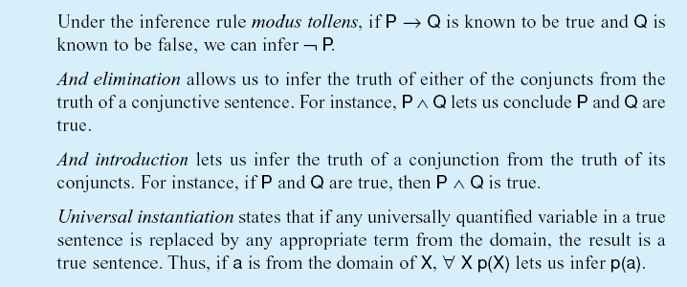

Slide 52
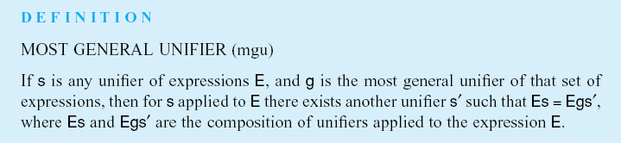
Luger: Artificial Intelligence, 6th edition. © Pearson Education Limited, 2009

Slide 53
INFERENCE WITH QUANTIFIERS
Universal Instantiation:
  Given ∀x, person(x) ⇒ likes(x, McDonalds)
  Infer person(John) ⇒ likes(John, McDonalds)
Existential Instantiation:
  Given ∃x, likes(x, McDonalds)
  Infer ⇒ likes(S1, McDonalds)
  S1 is a “Skolem Constant” that is not found anywhere else in the KB and refers to (one of) the indviduals that likes McDonalds.

Slide 54

UNIVERSAL INSTANTIATION
Every instantiation of a universally quantified sentence is entailed by it:
  for any variable v and ground term g
    ground term…a term with out variables
Example:
  ∀x King(x) ∧ Greedy(x) ⇒ Evil(x) yields
    King(John) ∧ Greedy(John) ⇒ Evil(John)
    King(Richard) ∧ Greedy(Richard) ⇒ Evil(Richard)
    King(Father(John)) ∧ Greedy(Father(John) ⇒ Evil(Father(John))

Slide 55

EXISTENTIAL INSTANTIATION
For any sentence α, variable v, and constant k that does not appear in the KB:
Example:
  ∃x Crown(x) ∧ OnHead(x, John) yields:
    Crown(C₁) ∧ OnHead(C₁, John)
    provided C₁ is a new constant (Skolem)

Slide 56
EXISTENTIAL INSTANTIATION
UI can be applied several times to add new sentences
  The KB is logically equivalent to the old
EI can be applied once to replace the existential sentence
  The new KB is not equivalent to the old but is satisfiable iff the old KB was satisfiable

Slide 57
REDUCTION TO PROPOSITIONAL INFERENCE
Use instantiation rules to create relevant propositional facts in the KB, then use propositional reasoning
Problems:
  May generate infinite sentences when it cannot prove
  Will generate many irrelevant sentences along the way!

Slide 58
REDUCTION TO PROPOSITIONAL INFERENCE
Suppose the KB had the following sentence
  ∀x King(x) ∧ Greedy(x) ⇒ Evil(x)
  King(John)
  Greedy(John)
  Brother(Richard, John)

Slide 59
REDUCTION TO PROPOSITIONAL INFERENCE
Instantiating the universal sentence in all possible ways…
  King(John) ∧ Greedy(John) ⇒ Evil(John)
  King(Richard) ∧ Greedy(Richard) ⇒ Evil(Richard)
  King(John)
  Greedy(John)
  Brother(Richard, John)
The new KB is propositionalized: propositional symbols are…
  King(John), Greedy(John), Evil(John), King(Richard), etc…

Slide 60
PROPOSITIONALIZATION
Every FOL KB can be propositionalized so as to preserve entailment
  A ground sentence is entailed by the new KB iff it is entailed by the original KB
Idea: propositionalize KB and query, apply resolution, return result
Problem: with function symbols, there are infinitely many ground terms
  For example, Father(X) yields Father(John), Father(Father(John)), Father(Father(Father(John))), etc.

Slide 61
PROBLEMS WITH PROPOSITIONALIZATION
Propositionalization tends to generate lots of irrelevant sentences
Example
    ∀x King(x) ∧ Greedy(x) ⇒ Evil(x)
    King(John)
    ∀y Greedy(y)
    Brother(Richard, John)
  Obvious that Evil(John) is true, but the fact Greedy(Richard) is irrelevant

Slide 62
UNIFICATION
Unification: The process of finding all legal substitutions that make logical expressions look identical
This is a recursive algorithm

Slide 63
UNIFICATION
We can get the inference immediately if we can find a substitution θ such that King(x) and Greedy(x) match King(John) and Greedy(y)
θ = {x/John, y/John} works
Unify algorithm takes in two sentences and returns a unifier if one exists
Unify(α,β) = θ if Subst(α, θ) = subst(β ,θ)

Slide 64
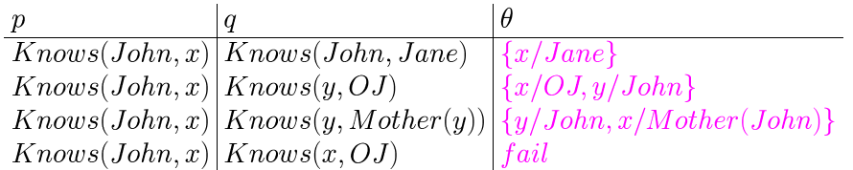
UNIFICATION
Standardizing apart- renaming variables to avoid name clashes
Unify(Knows(John,x),Knows(y, OJ)) ={x/OJ,y/John}

Slide 65
BASE CASES FOR UNIFICATION
If two expressions are identical, the result is (NIL) (succeed with empty unifier set)
If two expressions are different constants, the result is NIL (fail)
If one expression is a variable and is not contained in the other, the result is ((x /other-exp))

Slide 66

GENERALIZED MODUS PONENS
This is a general inference rule for FOL that does not require instantiation
Given:
  p1’, p2’ … pn’, (p1 ∧ … pn) ⇒ q
  subst(θ, pi’) = subst(θ, pi) for all p
Conclude:
  Subst(θ, q)

Slide 67
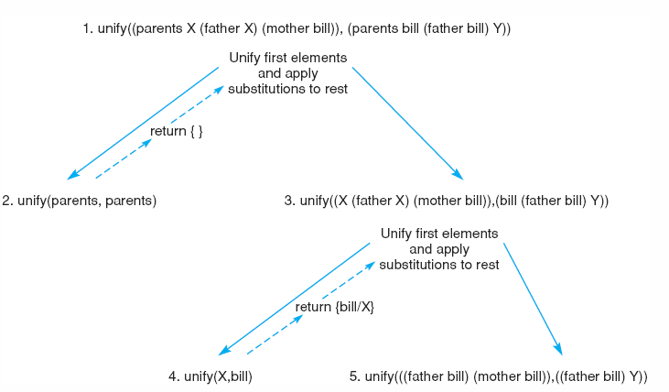
The unification of
(parents X (father X) (mother bill)) and (parents bill (father bill) Y).

Slide 68
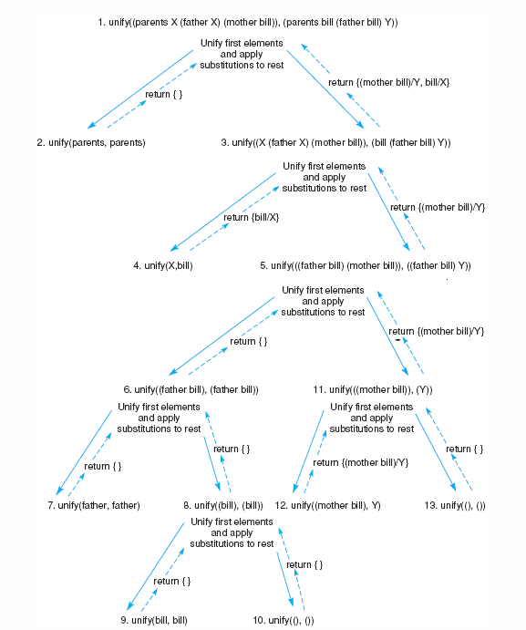
The unification of
(parents X (father X) (mother bill)) and (parents bill (father bill) Y).
Notes:
OWEN: Insert fig 2.6

Slide 69
APPLICATION
A Logic-Based Financial Advisor

Slide 70
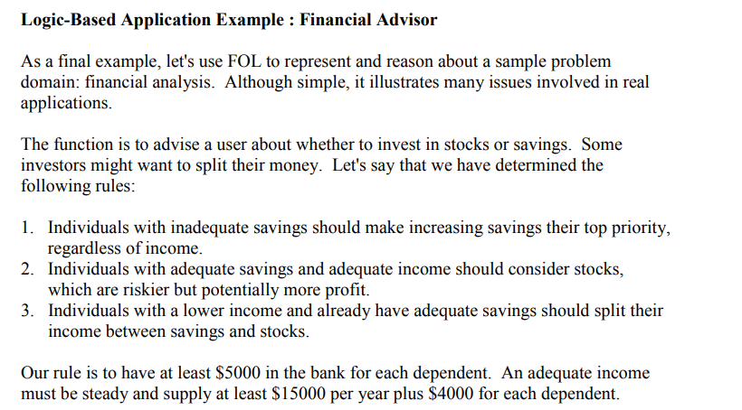

Slide 71
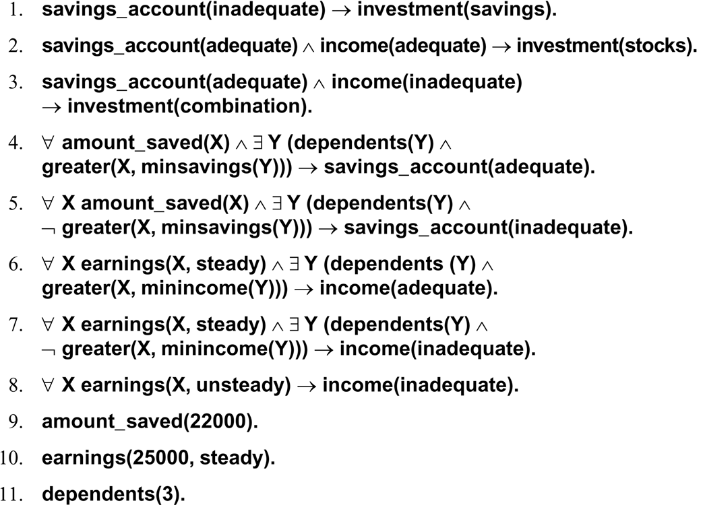
Luger: Artificial Intelligence, 6th edition. © Pearson Education Limited, 2009

